Slide 1
Chapter 20 - Girding for War: The North and the South (1861-1865) Chapter 21 - The Furnace of Civil War (1861-1865)

Slide 2
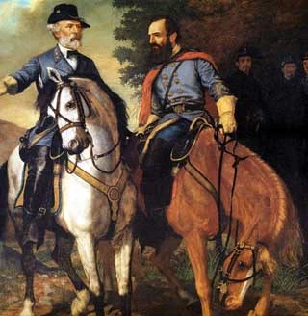
The Civil War
Northern Advantages:
More population
Industrial advantage
Southern Advantages:
Fought a defensive war
Military leadership

Slide 3
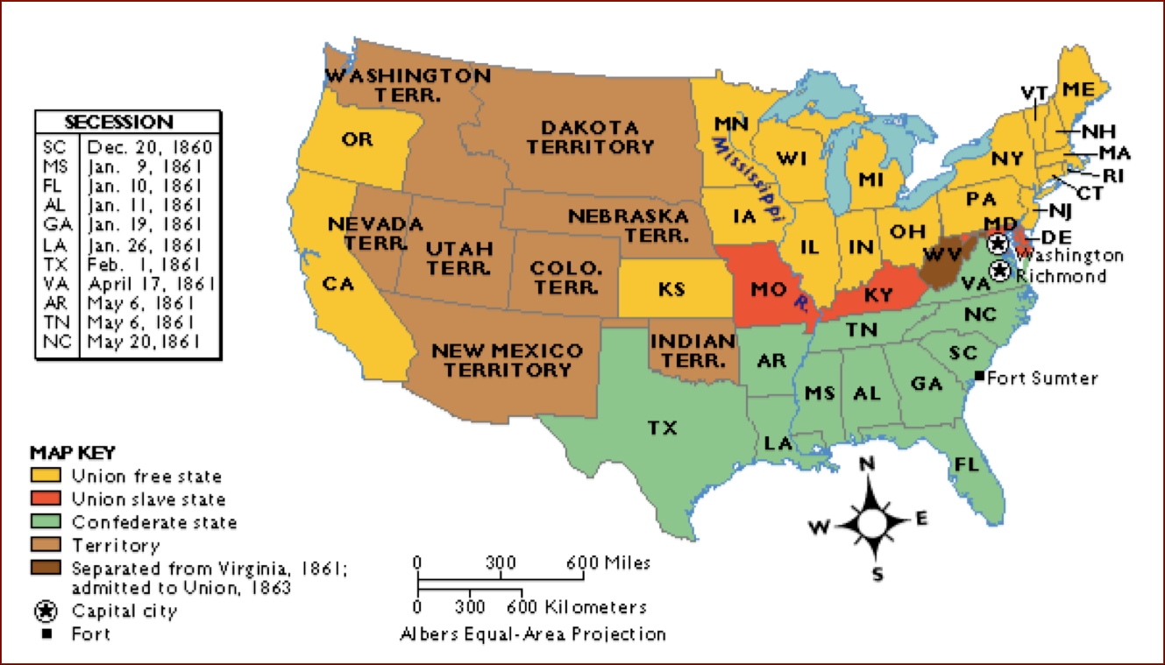
The Border States
What were they?
Missouri, Kentucky, Delaware, and Maryland
Why are they important?
Even though they had slaves, they remained loyal to, and fought on behalf, of the Union
Strategically located, industrialized

Slide 4
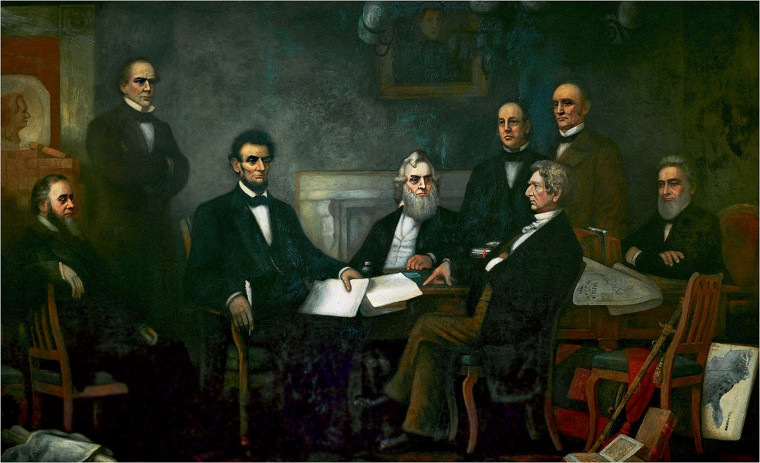
Emancipation Proclamation
Written after the Battle of Antietam:
Union victory, bloodiest day, helped to keep Europe out of war
Freed slaves in the states in REBELLION (Confederate States of America)
Did NOT free slaves in Border States
Impact of Emancipation:
Strengthened moral cause of war
Helped to keep Europe from intervening on behalf of CSA

Slide 5
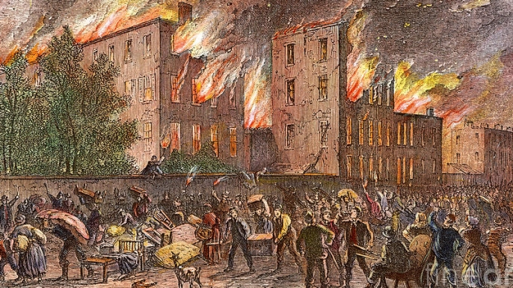
Key Terms during Civil War
Contraband:
Term for fugitive slaves that sought protection behind Union lines
Often fought for Union
Conscription:
Forced enlistment of citizens (draft)
New York City Riots
Class tensions between rich and poor (immigrants)

Slide 6
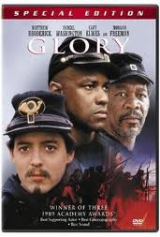
African Americans in Civil War
180,000 served in the Union Army
38,000 lost their lives
Encouraged to join by Frederick Douglass
Paid less than whites

Slide 7
Lincoln and the Civil War
Suspended Habeas Corpus:
Held people in jail without trial (Only Congress can do this)
Increased size of military (Only Congress can do this)
Shut down newspapers in D.C. and surrounding areas that were critical (violation of 1st amendment)
In times of crisis, personal liberties decrease, power of government increases

Slide 8
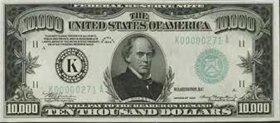
Key Congressional Decisions
National Banking System:
Salmon P. Chase (Treasury Secretary and 6th Chief Justice), from……..
Established Uniform National Currency
Homestead Act: Encouraged settlement of land out West
Tariffs increased (Morrill Tariff): Republicans controlled Congress; Republicans want to Raise tariffs
Morrill Land Grant:
Public land was to be donated to states for purpose of training students in agriculture and mechanical arts

